Slide 1
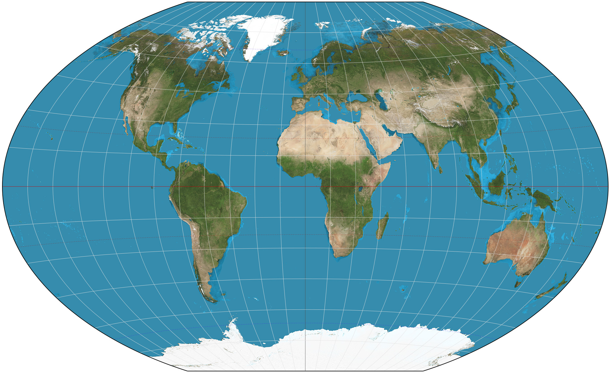
Spatiotemporal Epidemiology Methods
These slides are for use by eASIA JRP participants for educational purposes only. No slide or portions of slides can be copied or used in presentations, publications, or other public work without written permission of the author.

Slide 2
What is Spatiotemporal Epidemiology?
Studies how disease patterns vary across space and time
Useful for identifying clusters, trends, and risk factors
Involves tools like mapping, statistics, and time-series models

Slide 3
Core Spatiotemporal Methods
1. Cluster Detection (SaTScan)
2. GIS Mapping & Interpolation
3. Regression Modeling
4. Time-Series and Lag Models
5. Multi-Method Comparisons

Slide 4
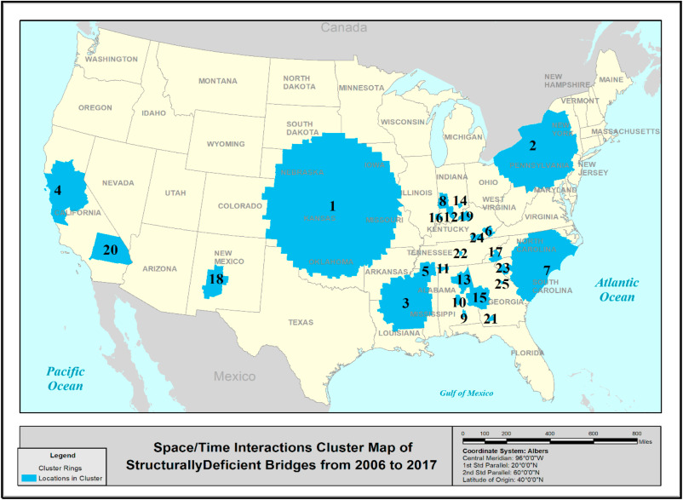
Cluster Detection with Spatial Scan Statistics (SaTScan)
Finds clusters of high disease rates using moving windows
Tests each zone for unusually high case counts
Uses Poisson or Bernoulli models

Slide 5
Multi-Method Comparison & Flexible Cluster Tools
Uses multiple scan methods for better cluster detection
PreCoG combines circular, elliptical, and flexible shapes
Flexible methods find realistic, irregular clusters

Slide 6
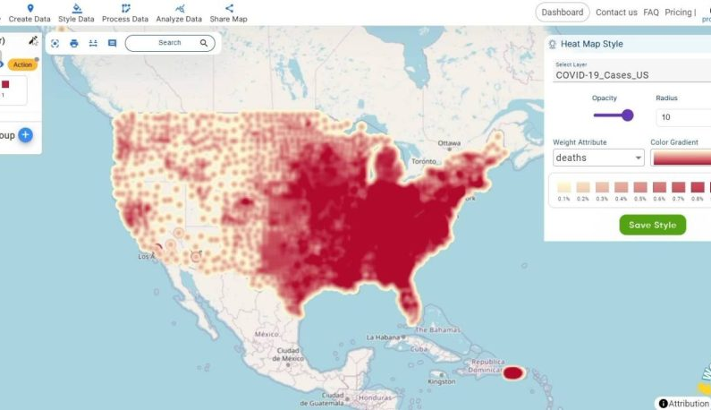
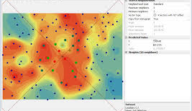
GIS Mapping & Spatial Interpolation (Kriging)
Maps environmental variables across space
Estimates exposure at unsampled locations
Assumes nearby values are more alike

Slide 7
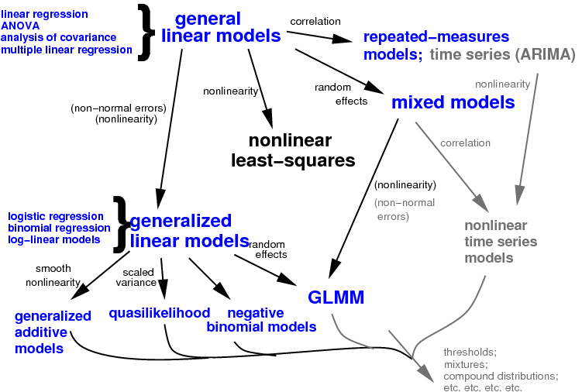
Regression Modeling (Logistic, Poisson, GLMM)
Explores associations between environment and disease
Logistic: yes/no outcomes; Poisson: counts
GLMM: includes random effects for clustering

Slide 8
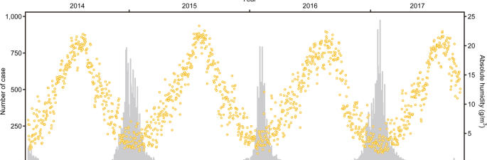
Time-Series & Lagged Climate Models
Studies delayed effects of climate on infections
Includes lagged predictors like rainfall months before
Uses GAMs and distributed lag models

Slide 9
Considerations for NTM
Dealing with both environmental and host effects
Time lag between environmental exposure and disease unknown.
Variable selection: we have so many climate variables…which are important?

